Slide 1
Digital Watermarking and Steganography - Mini Project SoSe 2019
Group 11: Sarah Böning, Anh Phoung Lee, Kai Gerrit Lünsdorf

Slide 2
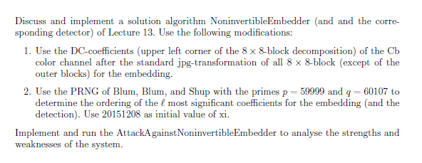
The Exercise

Slide 3
Our Interpretation
Implement 3 algorithms: Embedder, Attacker, Detector
Embedder: follows given algorithm, but embed watermark on a random path (generated by BBS) of the upper left corner DCT coefficients of the Cb-colour channel
Detector: Takes watermarked & original image and computes the similarity
Attacker: follows given algorithm, tries to embed his own watermark
Analysis of the Watermarking System
Rightful Ownership Problem (Multiple public watermarked images)
Robustness
Number analysis
Python 3

Slide 4
Implementation - Embedder
Input: c, w, α, key, Output: s
b = hashImage(c)
d = jpgDCT(c)
p = getBBSPath(key)
Embed w following p
If b_{i} = 0: d_{i} = d_{i} + (1+α*w_{i})
else: d_{i} = d_{i} + (1-α*w_{i})
S = inverseJpgDCT(d)

Slide 5
Implementation - Attacker

Slide 6
Implementation - Detector
Pseudocode of our own implementation
Some explanations maybe

Slide 7
Analysis
Evaluate the watermarking system
Evaluate the security & robustness of the watermarking system
Find weaknesses and strengths
Expectations:
Secure iff key (BBS parameters) is different
Not secure if key are the same
Problems when all 3 use different keys
No visible differences between c, c‘, s & s‘

Slide 8
Analysis - Procedure
Take several photos with different features
Run the 3 algorithms
Vary: original images c, length of watermark
Statistical tests
χ ² test, number analysis, robustness, fidelity, histograms

Slide 9
Analysis - The Photo Set
Sets with different features for a differentiable evaluation
High contrast
Low contrast
Black and white
Highly textured
Monochrome
„Normal“ pictures / amateur photography
5 in each set (30 in total)

Slide 10





High Contrast

Slide 11


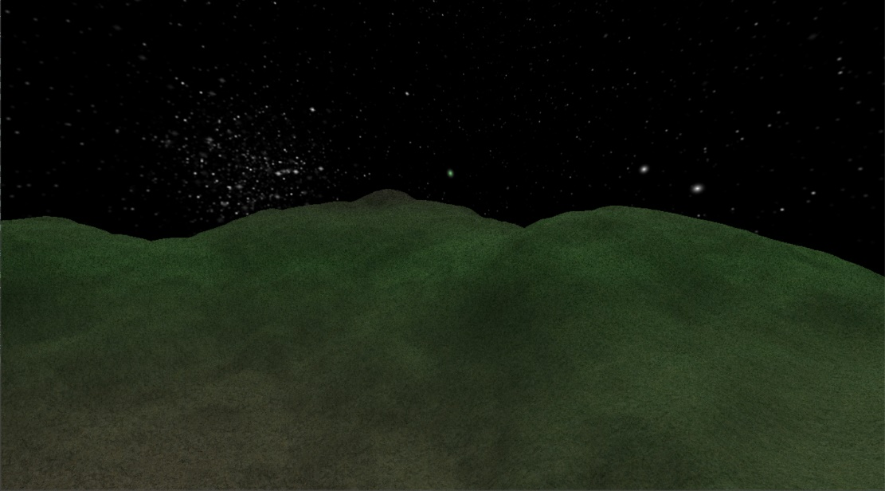

Low contrast

Slide 12


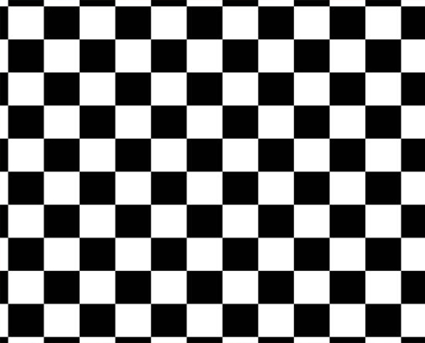

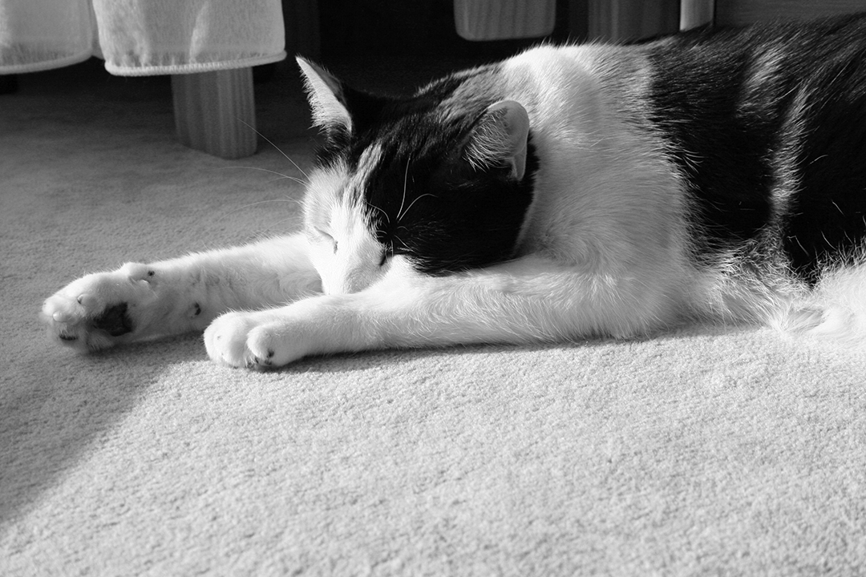
Black and White

Slide 13



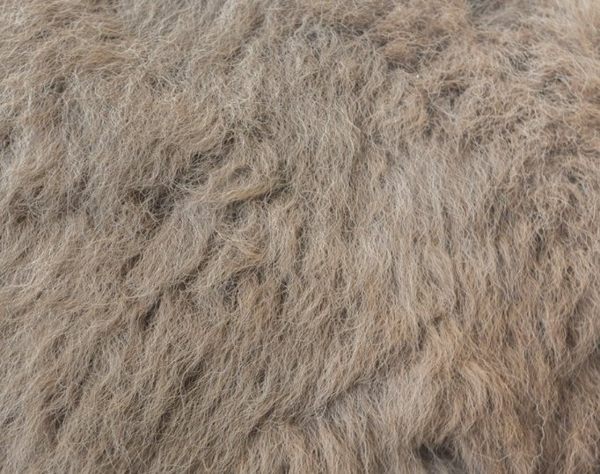
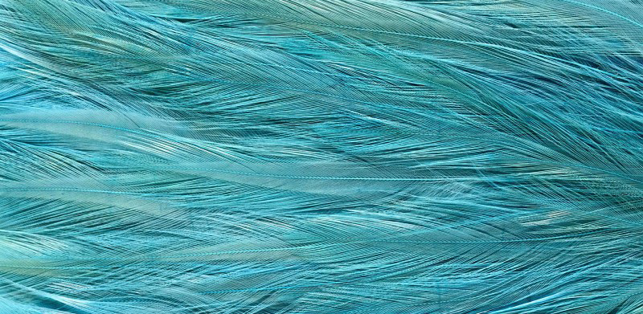
Highly Textured

Slide 14



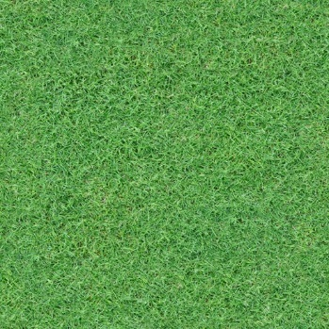

Monochrome

Slide 15
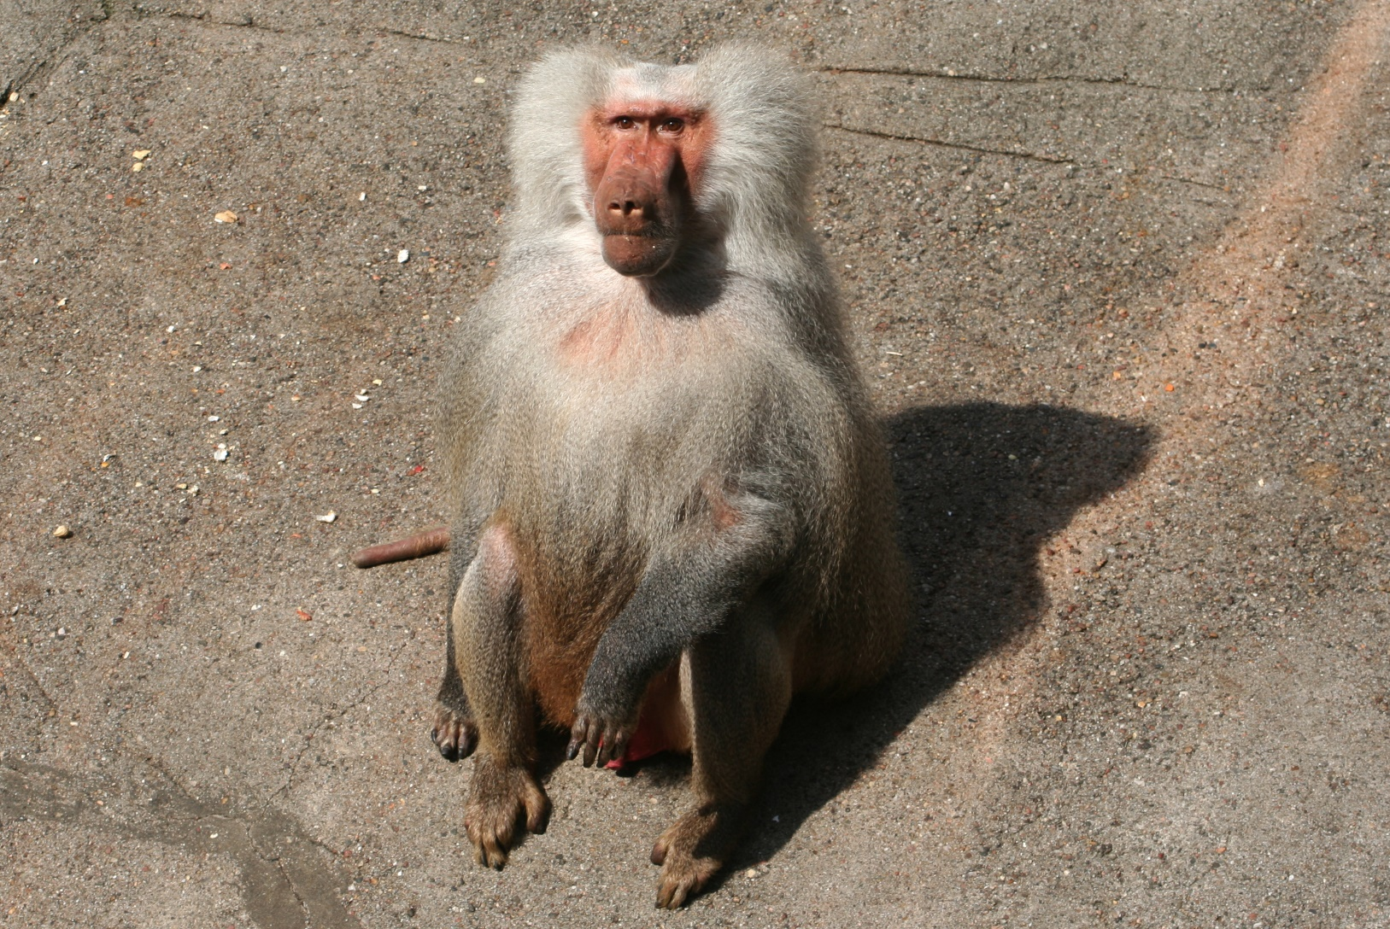
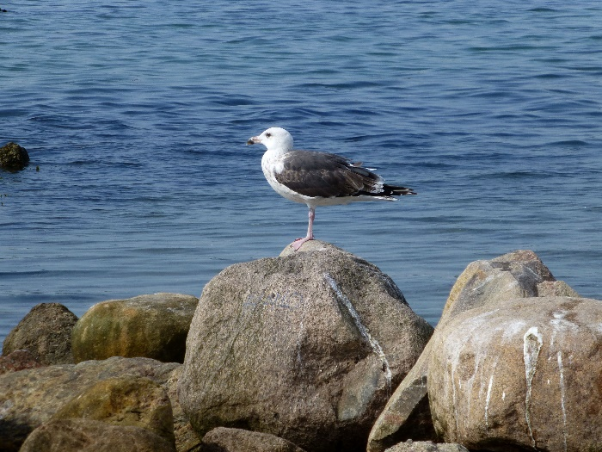
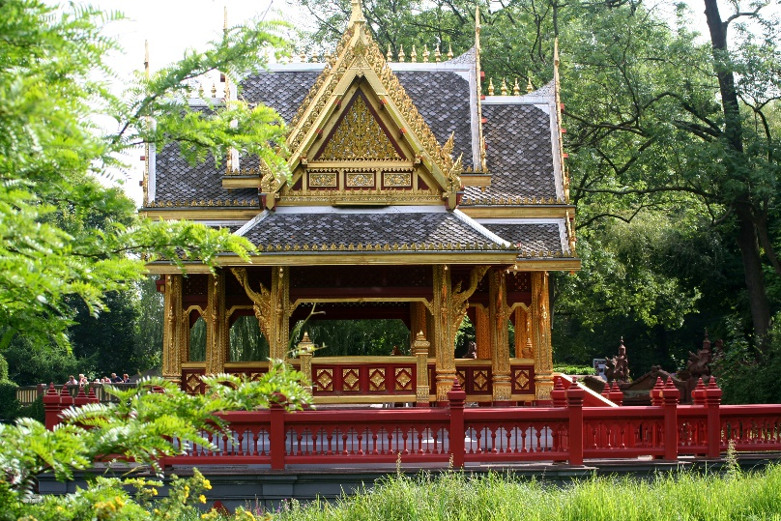
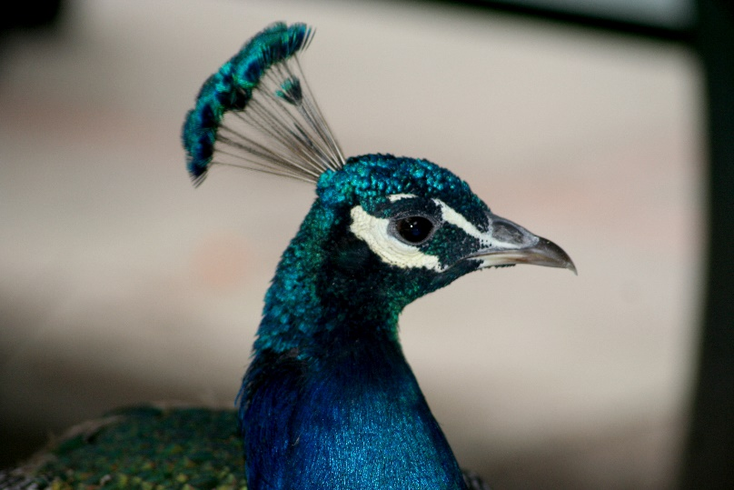
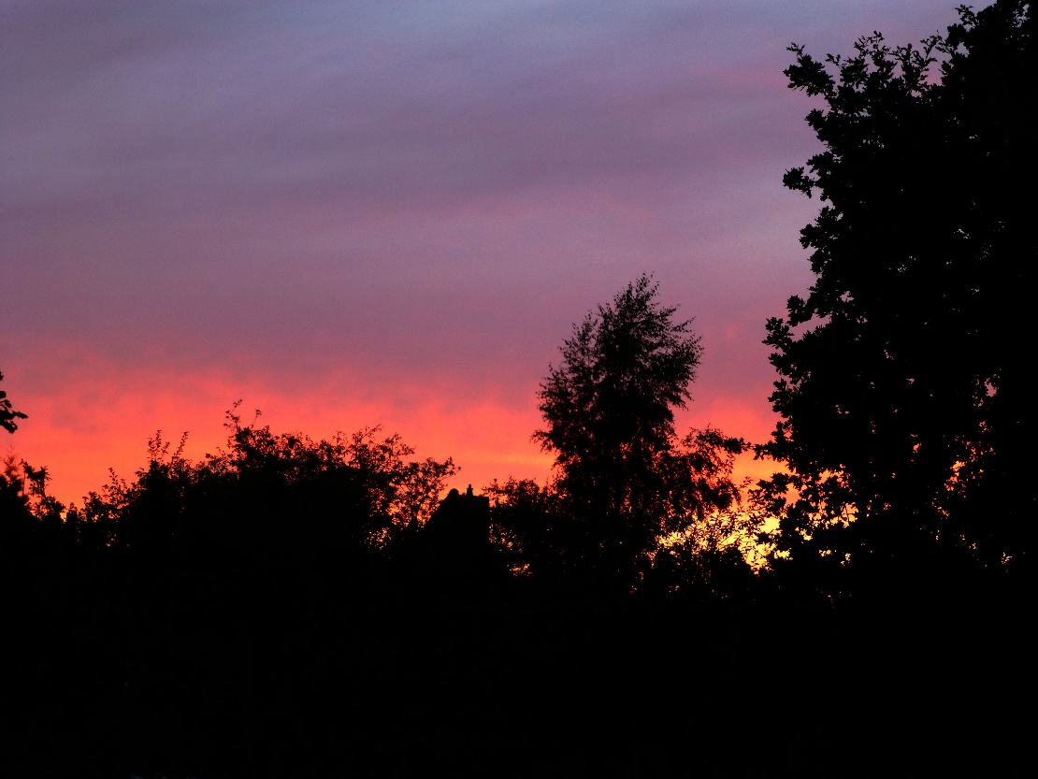
Amateur photography

Slide 16
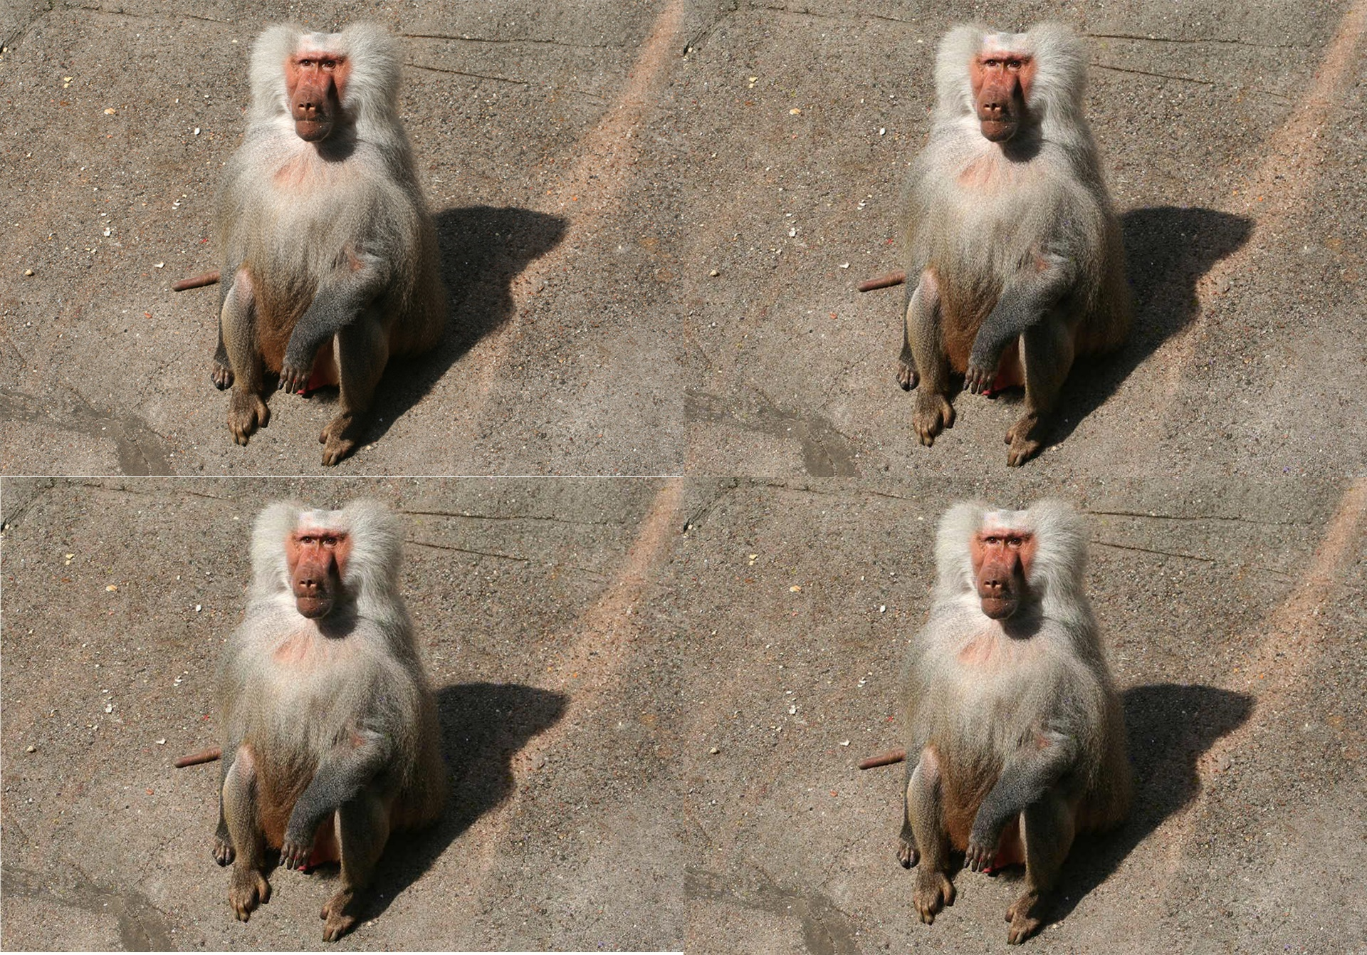
Perceptibility – Which is which?

Slide 17
Analysis – Number Analysis
Averages, majorities, means, no of changed pixels, differences in coeffs/pixels/images etc.

Slide 18
Analysis - χ² Test

Slide 19
Analysis - Histograms

Slide 20
Analysis - Fidelity

Slide 21
Analysis - Robustness

Slide 22
Analysis – Watermark Lengths

Slide 23
Analysis Summary & Conclusion
Is it safe against the Rightful Ownership Problem & the Attacker with multiple public images?
Is is safe in general/ against other attacks?
Strenghts and weaknesses of our wm system
How good are our results/limitations
Etc.

Slide 24

Any questions?
Thank you for your attention.

Slide 25
References
Lecture notes „Digital Watermarking and Steganography SoSe 2019“, Andreas Jakoby, Bauhaus University Weimar
Craver, Scott & Memon, Nasir & Yeo, Boon-Lock & Yeung, Minerva. (1997). On The Invertibility Of Invisible Watermarking Techniques. 1. 540 - 543 vol.1. 10.1109/ICIP.1997.647969.
Code: Python 3.6, Numpy 1.16, matplotlib 3
Images: private, textures.com, rawpixel.com, newevolutionsdesign.com, desktopimages.org, wikipedia

